Slide 1
Python Session 5.2 – Exception Handling

Slide 2
Exceptions
Exceptions are events that can modify the flow or control through a program.
They are automatically triggered on errors.
try/except : catch and recover from raised by you or Python exceptions
try/finally: perform cleanup actions whether exceptions occur or not
raise: trigger an exception manually in your code
assert: conditionally trigger an exception in your code

Slide 3

Syntax Errors
Syntax errors, also known as parsing errors, are perhaps the most common kind of error you encounter while you are still learning Python.
The parser repeats the offending line and displays a little ‘arrow’ pointing at the earliest point in the line where the error was detected. The error is detected at the token preceding the arrow. File name and line number are printed so you know where to look in case the input came from a script.

Slide 4
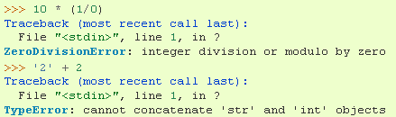
Exceptions
Even if a statement or expression is syntactically correct, it may cause an error when an attempt is made to execute it. Errors detected during execution are called exceptions and are not unconditionally fatal.
Most exceptions are not handled by programs, however, and result in error messages like “cannot divide by zero” or “cannot concatenate ‘str’ and ‘int’ objects”.

Slide 5
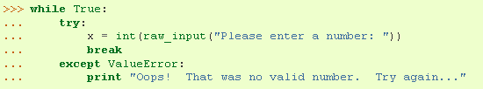
Handling Exceptions – try/except
First the 'try' clause is executed until an exception occurs, in which case the rest of 'try' clause is skipped and the 'except' clause is executed (depending on type of exception), and execution continues. If an exception occurs which does not match the exception named in the except clause, it is passed on to outer try statements; if no handler is found, it is an unhandled exception and execution stops.

Slide 6
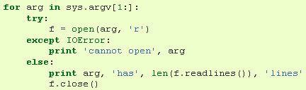
Try/Except/Else
The try-except statement has an optional else clause, which, when present, must follow all except clauses. It is useful for code that must be executed if the try clause does not raise an exception.

Slide 7
Try/finally
In try/finally, finally block is always run whether an exception occurs or not The try statement has another optional clause which is intended to define clean-up actions that must be executed under all circumstances.
Ensure some actions to be done in any case
It can not be used in the try with except and else.

Slide 8

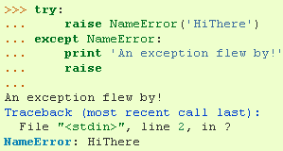
Raising Exceptions
The raise statement allows the programmer to force a specified exception to occur.
The sole argument to raise indicates the exception to be raised.
A simpler form of the raise statement allows one to re-raise the exception (if you don’t want to handle it):

Slide 9
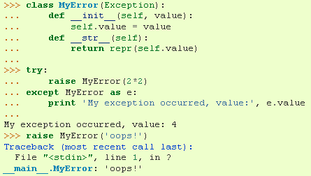
User-defined Exceptions
Programs may name their own exceptions by creating a new exception class. These are derived from the Exception class, either directly or indirectly.
Here, the def __init__() of Exception has been overridden. The new behavior simply creates the value attribute.

Slide 10
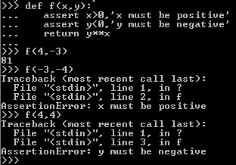
ASSERT
assert is a conditional raise
assert <test>, <data>
assert <test>
If <test> evaluates to false, Python raises AssertionError with the <data> as the exception’s extra data.

Slide 11
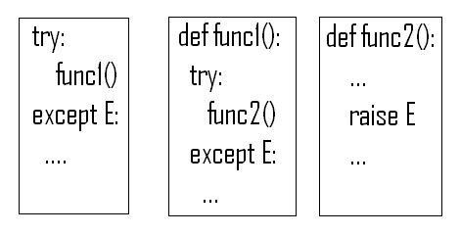
NESTING EXCEPTION HANDLERS
Once the exception is caught, it’s life is over.

Slide 12
Built-in Exceptions
Exception - All built-in, non-system-exiting exceptions are derived from this class. All user-defined exceptions should also be derived from this class.
StandardError - The base class for all built-in exceptions except StopIteration, GeneratorExit, KeyboardInterrupt and SystemExit. StandardError itself is derived from Exception.
ArithmeticError - The base class for those built-in exceptions that are raised for various arithmetic errors: OverflowError, ZeroDivisionError, FloatingPointError.
BufferError - Raised when a buffer related operation cannot be performed.
LookupError - The base class for the exceptions that are raised when a key or index used on a mapping or sequence is invalid: IndexError, KeyError. This can be raised directly by codecs.lookup().
AssertionError -Raised when an assert statement fails.
AttributeError - Raised when an attribute reference (see Attribute references) or assignment fails. (When an object does not support attribute references or attribute assignments at all, TypeError is raised.)
IOError - Raised when an I/O operation (such as a print statement, the built-in open() function or a method of a file object) fails for an I/O-related reason, e.g., “file not found” or “disk full”. This class is derived from EnvironmentError. See the discussion above for more information on exception instance attributes.

Slide 13
ImportError - Raised when an import statement fails to find the module definition or when a from ... import fails to find a name that is to be imported.
IndexError - Raised when a sequence subscript is out of range. (Slice indices are silently truncated to fall in the allowed range; if an index is not a plain integer, TypeError is raised.)
KeyError - Raised when a mapping (dictionary) key is not found in the set of existing keys.
KeyboardInterrupt - Raised when the user hits the interrupt key (normally Control-C or Delete). During execution, a check for interrupts is made regularly. Interrupts typed when a built-in function input() or raw_input() is waiting for input also raise this exception. The exception inherits from BaseException so as to not be accidentally caught by code that catches Exception and thus prevent the interpreter from exiting.
MemoryError - Raised when an operation runs out of memory but the situation may still be rescued (by deleting some objects). The associated value is a string indicating what kind of (internal) operation ran out of memory. Note that because of the underlying memory management architecture (C’s malloc() function), the interpreter may not always be able to completely recover from this situation; it nevertheless raises an exception so that a stack traceback can be printed, in case a run-away program was the cause.
NameError - Raised when a local or global name is not found. This applies only to unqualified names. The associated value is an error message that includes the name that could not be found.

Slide 14
Exercise 1
Write a function called oops that explicitly raises an IndexError exception when called.
Write another function that calls oops inside a try/except state­ment to catch the error.
What happens if you change oops to raise KeyError instead of IndexError
Change the oops function you just wrote to raise an exception you define yourself, called MyError, and pass an extra data item along with the exception.

